Slide 1
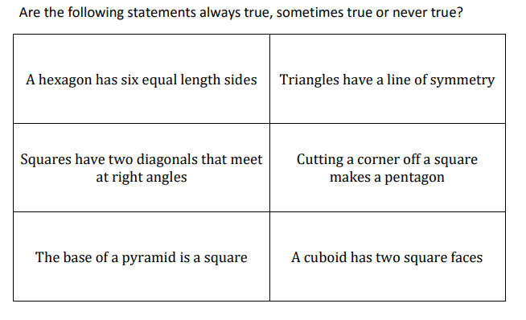
Always, Sometimes, Never
3 – Talking Points
Always, Sometimes, Never

Slide 2
Would You Rather
3 – Talking Points
Notes:
‘

Slide 3
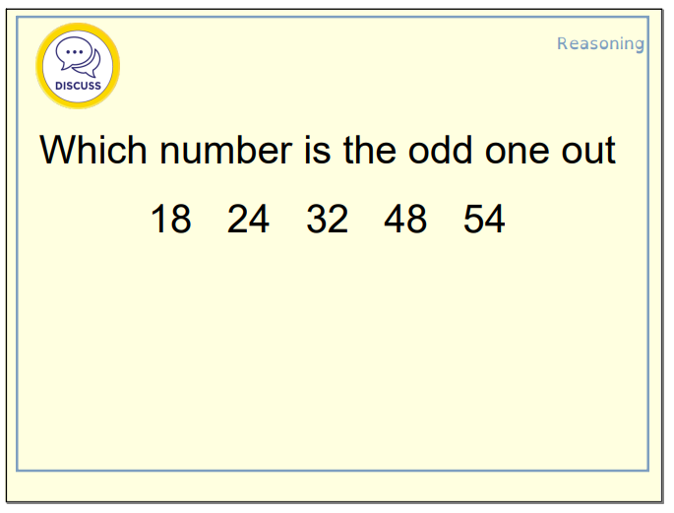
Odd One Out
3 – Talking Points

Slide 4
3 – Talking Points
Partner A
“I agree with this statement because…”
“I think the evidence would suggest that…”
Partner B
“I disagree with this statement because…”
“I would challenge what you said because…”
Talking and thinking are the same thing
It is rude not to join in with a group discussion
SPIN
It is easier to talk well than it is to write well

