Slide 1
Judaism
Developing a deeper understanding.
Year 3

Slide 2
There are six major religions in our world.

Slide 3
Judaism…going deeper!
Age group | Theme | Topic
Early Years | Special days / ritual objects | Hanukkah
Year 1 | Stories | Moses
Year 2 | Prayer / home | Daily prayer
Year 3 | Places of worship | Jerusalem
Year 4 | Holy Books | Exploring the Torah
Year 5 | Beliefs and festivals | Mitzvot
Year 6 | Belonging and values | Life as a Jew

Slide 4
Week 1

Slide 5
KS2
Watch this video to refresh your learning about Judaism.
https://www.truetube.co.uk/film/alien-abduction-judaism

Slide 6
Places of Worship for Judaism
Jerusalem has some very holy places for Jewish people.
Let’s investigate and find out more about these places.

Slide 7
Can you find Israel on the map?

Slide 9
Jerusalem is in Israel which is part of The Holy Land.
Jerusalem is an important holy place for Judaism, Islam and Christianity.

Slide 11
Jerusalem remains an important place of pilgrimage for Jewish people. Until the destruction of the Second Temple in 70 CE and the Roman occupation of the city, it used to be a duty for Jewish people to visit Jerusalem three times every year, to coincide with three major Jewish festivals - Pesach, Shavuot and Sukkot.
According to Jewish tradition, all of creation began in Jerusalem. Other key events are believed to have happened in this important city, including:
Mount Moriah, where Abraham showed he was prepared to sacrifice his son, Isaac. It was also here that Jacob dreamed of a ladder that went up to Heaven.
King David captured Jerusalem around 3,000 years ago and made it the capital of the ancient Jewish people.
King Solomon built the first Temple in Jerusalem. The Ark of the Covenant is believed to have been kept in the most sacred part of the Temple, the Holy of Holies, the place where it was believed God himself was present.

Slide 12
The first Temple was destroyed around 587 BCE, when a large proportion of the Jewish people were expelled from Jerusalem by the Babylonians and exiled to Babylonia. The Second Temple was built by the Jews after their return from Babylonia when Jerusalem was ruled by the Persian King Cyrus, and completed in 515 BCE. It was destroyed in 70 CE by the Romans.

Slide 13
The Western Wall
The Western Wall, or the Kotel, is thought to be the only remaining part of the Second Temple. The wall is not from the Temple itself, but what remains of the wall that would have surrounded the Temple.

Slide 14
Visiting The Western Wall is a reminder to Jewish people of their history, but also gives them a link with the holiest site, the Temple. It is the closest Jewish people can get to the presence of God.
Also, as the Western Wall has not been destroyed, it is a symbol of hope to the Jewish people that they too will last forever. Some Jews believe that a third Temple will be built when the Messiah comes in the future.

Slide 15
People write prayers on small pieces of paper and push them in between the cracks of the wall.
As Jews believe that the wall is a symbol of God's presence, many believe that God can actually see what has been written.
The prayers are collected twice every year and then buried on the Mount of Olives.
Watch this video
https://www.bbc.co.uk/teach/class-clips-video/religious-studies-ks2-visiting-jerusalem/z76d7nb

Slide 16
Show your learning…
Over the next two weeks you are going to make a leaflet about Jerusalem for Jewish people.
This week:
Create a title page
Include information and pictures about the Western Wall.

Slide 17
Examples of leaflets

Slide 18
Week 2

Slide 19
The Temple Mount is the elevated plaza above the Western Wall in Jerusalem that was the site of both of Judaism’s ancient temples. The platform of the Temple Mount is supported by four huge supporting walls, built from large chiseled stones that were placed on top of each other. One of the supporting walls is the Western Wall, which serves today as a site for prayers and gatherings.
The site is also the third holiest in Islam (after Mecca and Medina) and has been a focal point of inter-religious tension for decades.
At present, the site is ruled by Israel but is looked after by the Muslim Waqf (religious trust). Jews and other non-Muslims are permitted to visit, but Jewish prayer is forbidden there. This has caused fighting in the past.

Slide 20
The Temple Mount, known in Hebrew as Har Habayit, is traditionally said to be the site where Abraham showed his devotion to God by taking his son Isaac to be sacrificed. The mount is also the site of both ancient Jewish temples.
The first, built by King Solomon, was destroyed by the Babylonians in 586 BCE. The second was built in the sixth century BCE and stood for nearly 600 years before it was destroyed and the Jewish people exiled in 70 CE by the Roman Empire.
https://www.youtube.com/watch?v=8IOly3-M96M

Slide 21
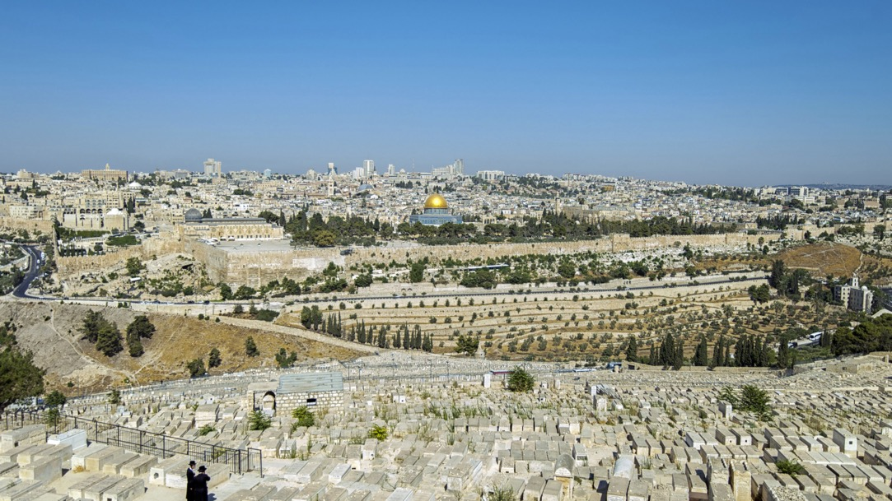
The Mount of Olives has been a Jewish cemetery since biblical times. It can be seen in full sunlight from the direction of Temple Mount. There are over 150,000 gravestones all across the western slope of the mount.
Jews have been buried there for years but less so more recently because it is over crowded. Some very important Jewish people from history have their grave there, including King David’s son Absalom.

Slide 22
Show your learning…
You have been making a leaflet about Jerusalem for Jewish people.
This week:
Include information and pictures about the The Temple Mount and The Mount of Olives.
Challenge: Why do you think it is important for Jews to visit Jerusalem?

