Slide 1
Year 5 – Writing Assessment Activities Pack
Warm-up Activities
You might want to use one of the warm-up activities before your child starts writing. These are designed to be fun and to develop and hopefully increase your child’s vocabulary and perhaps even help with their spelling.
Activity 1: A Guide to … (writing to inform/interest)
Activity 2: Leaflet (writing to inform/persuade/interest)
Activity 3: Job Application Letter (writing to persuade/inform )
There is no time limit for each of these activities. One activity might, for example, be done over a series of days. Children should attempt at least two out of the three activities. Completed activities should be submitted before …

Slide 2
Year 5 – Word Warm-Ups
Snappy Caption
Use alliteration to write a snappy caption.
Strong synonymns
Explore the power of words and make conscious choices in writing.
Grab the reader
Sometimes writers put in too much detail in their writing and the reader loses interest. The challenge is to grab the reader: are you up to the challenge?

Slide 3
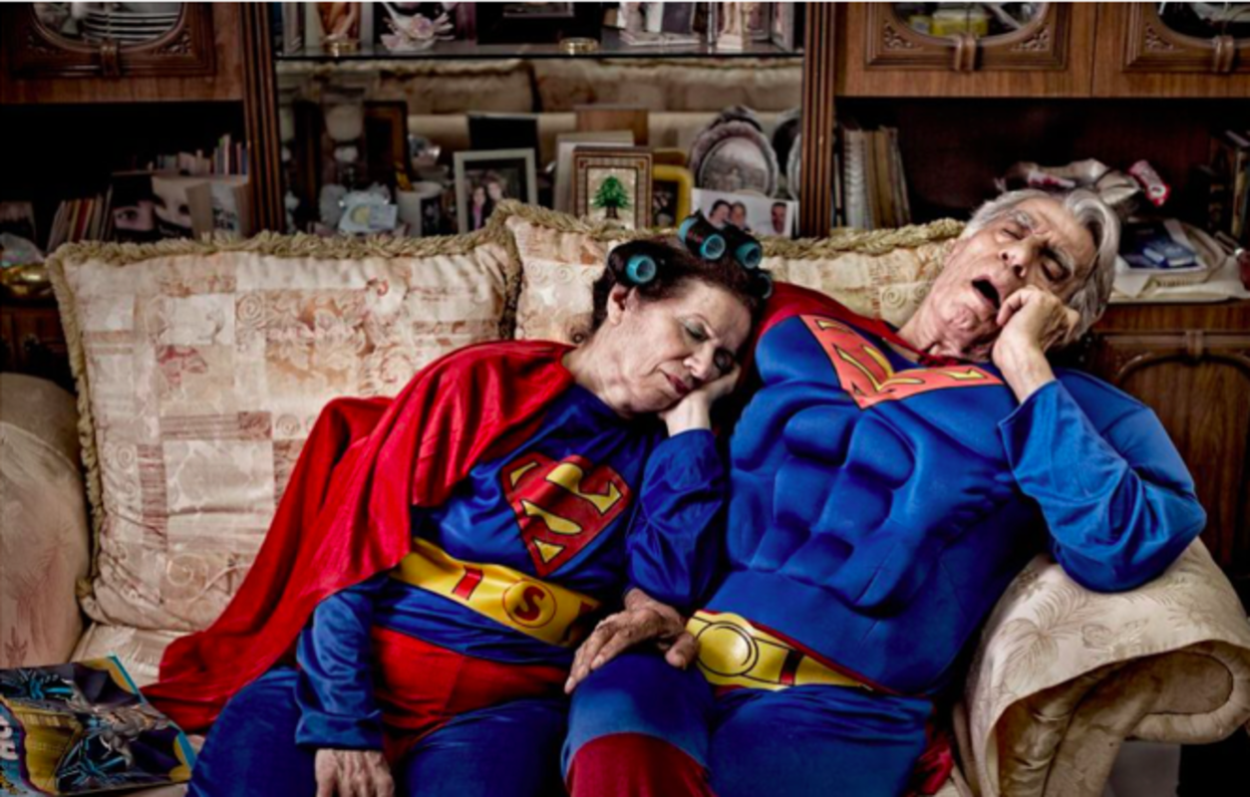
Wordy Warm – Ups
Is this what happens to superheroes?
Imagine this photo is going to be displayed in a gallery. Think of a snappy caption to go with the picture. Try to use alliteration (every word starting with the same letter.)
Pobble 365 Photo courtesy of Martin Beck, Bored Panda.
Strong synonyms
When we write we want to use the most powerful words that we can to grab the reader and make them want to read on. How many different words can you think of for …
Now order each one: which is the most powerful? Which is the least powerful?
strong
tired
fast
fly
good

Slide 4
Wordy Warm - Up
Really effective writing ‘grabs’ the reader. This description does not grab the reader. Improve the paragraph so that it does grab the reader and make them want to read on. Carefully choose the words you use. Remember sometimes less is more!
The hall had lots and lots of books on shelves. It also had a nice ceiling. There were globes in a line down the middle of the room. There were also come clocks which were in between the globes.
Pobble 365
Photo courtesy of Sean J Yan www.onebigphoto.com

Slide 5
Notes for parents
These activities are designed to assess what children can do independently.
Children will need help in reading and understanding each task. They will benefit from your encouragement whilst they are doing each one, but please ensure that the ideas and the work are the children’s own.
We are not expecting or looking for perfection, any mistakes your child may make will help us plan their next steps in learning.
If you do help, or support your child in any way please can you make a note so that we know if certain parts have been aided by an adult. E.g. Edna asked how to spell the words underlined and I helped her sound them out/use her word mat OR Edgar needed lots of encouragement to start his invitation so we wrote the first sentence together.
More than anything try to allow your child’s imagination to shine through. Ask them, and encourage them, to do the very best they can by motivating them with praise for their efforts. Do feel free to make suggestions to your children but try to phrase them as questions rather than giving them the answer. E.g. Have you used your word mat to help you with your spelling?

Slide 6
Year 5 – Activity 1 – A Guide to …
In the story Who Let the Gods Out? By Maz Evans, Elliot is about to meet some Greek Gods. Each god had a specific role e.g. god of the sky. Your challenge is to create a new Greek God and create a guide about them for other children of your age.
Think about:
How to set out your guide
The introduction and the conclusion to your guide
The information that needs to go the guide
Ꙭ What is the new god’s name?
Ꙭ What do they look like?
Ꙭ What powers/special talents do they have?
Ꙭ How are they related to other gods?
Ꙭ Any other information that you feel is important
A Guide to …

Slide 7
Year 5 – Activity 1– A Guide to … – Planning Sheet
Think about the information/guide books you have looked at/read before to help you. Think about how the pages look. How will you organise your information sheet?
What information do you need to include? What vocabulary might be useful?
What sentence structures might you use? Remember this is a guide for children of your age.
How are you going to finish your information sheet?
.
Don’t forget you are writing a guide for Year 5 children.
Think carefully about how to start and end your guide.

Slide 8
Year 5 – Activity 2 – Leaflet
Imagine that your new god has a new gadget. In order to get some money to re-decorate the Hall of the Gods they want to sell a toy version of the gadget to the mortals on Earth.
Your task is to create a leaflet they explain what the gadget is and what is does but also to persuade children (or their parents to buy it.)
Think about the layout of the leaflet. Remember you are writing it for children of your age and/or their parents. You may wish to include diagrams that are labelled. Think about an introductory paragraph and a concluding paragraph. Think about the type of language you will need to use to persuade someone to want to buy the gadget. Think about the power of words.

Slide 9
Year 5 – Activity 2– Leaflet – Planning Sheet
Think about the leaflets you have looked at/read before to help you. Think about how the pages look. How will you organise your leaflet?
What key information do you need to include? What vocabulary might be useful?
What sentence structures might you use? Remember you are writing to persuade.
How are you going to finish your information sheet?
.
Don’t forget this is a leaflet
for a new toy.
It needs to be persuasive,
Think carefully about how to start and end your leaflet.

Slide 10
Year 5 – Activity 3 – Job Application Letter
The Hall of the Gods is looking for a new god to apply for a vacant position after the banishment of the evil daemon Thanatos. Read through the job advert and then write a letter to Zeus . Remember this is an official letter. Think about the language you will need to use and how to set your letter out. Remember you want to persuade him that you are the right one for the job.
Are you the god we are looking for?
This is a once in a lifetime opportunity to join the Hall of the Gods.
A prestigious position that brings with it a great deal of responsibility.
We are looking for a god with power and wisdom.
If that is you write to Zeus today.
Task:
Write a letter to Zeus to apply for the job.
Remember to include the experience you have as a god and what you think you can offer the Hall of Gods. Why are you the right one for the job?

Slide 11
Year 5 – Activity 3– Letter – Planning Sheet
Think about a letter you have written/read before to help you. Think about how the letter looked. How should you layout your letter?
What key information do you need to include? What vocabulary might be useful?
What types of sentence might you use? Remember you are writing to persuade and to inform.
How are you going to finish your letter?
.
Don’t forget this is a letter to apply for a job and that you are writing to someone you do not know.
Think carefully about how to start and end your letter.

Slide 12
Writing Checklist
Read it aloud to someone else OR ask someone to read it to you. Does it make sense all the way through? Does it have a beginning and an end?
Have you matched the words and sentence structures you have used to the type of writing?
Does the writing do what it is supposed to do? e.g. entertain, inform, interest, persuade
Have you chosen the words that you have used carefully to grab the reader?
Have you used the correct punctuation where you need it?
Have you stuck to the same tense throughout your writing?
Have you used organised your writing/used paragraphs correctly?
Have you checked your spelling? Remember you can use word mats/dictionaries.
Is your handwriting the best it can be?
Don’t forget to check your writing and
make changes and/or
corrections if you need to.

