Slide 1
XCET Online Science Leaders Meeting
Notes:
1

Slide 2
Aims
How to teach working scientifically with limited/no resources and without group working.
How to keep science lesson interesting and engaging.
How to effectively link Science with English and Maths.
How to support your colleagues to teach science effectively in the 'new normal’.

Slide 3
House keeping
Chat
Raise hand
40 minute cut off – but we’ll come back

Slide 4
Well Being
What’s the situation in your school at the moment?

Slide 5
The new normal…
Little or no access to resources
Teachers with different age groups/children
Not familiar with the curriculum/attainment of the children
Teachers in different classroom
No paired/group work
Reduced team
TAs
Worried/stressed colleagues

Slide 6
The new normal…
Mitigation phase
Now to September?
Managing increasing numbers as safely as possible
Compensation phase
September? onwards
Fill gaps in learning/making up for lost time

Slide 7
The new normal…
Mitigation phase
Main focus on webinar…
Compensation phase
Coming up…
SL/Colleagues identify what children have missed – inform their new teachers.
Content
Science week/additional topic/add into existing topics
ASE Knowledge progression grids
Working scientifically
Running through all topics – which areas were particularly missed?

Slide 8
The new normal…
Mitigation phase
Science is a core subject – it must still be taught.
Children’s well being
Anything is better than nothing
Down with Twinkl!
Year 6
Measuring accurately, reading scales
Drawing and interpreting line graphs
Fair testing (physics/chemistry)
Explorify, https://explorify.wellcome.ac.uk/blog/explorify-and-developing-key-skills

Slide 9
The new normal…
Mitigation phase
PSTT
Science at work, https://pstt.org.uk/resources/curriculum-materials/Science-at-Work
Science at home, https://pstt.org.uk/resources/curriculum-materials/Science-Fun-at-Home
Science for one, https://pstt.org.uk/resources/curriculum-materials/Science-for-One

Slide 10
The new normal…
Mitigation phase
Explorify
BBC Bitesize Daily Lessons, https://www.bbc.co.uk/bitesize/dailylessons
BBC Terrific Scientific, https://www.bbc.co.uk/teach/terrific-scientific
Colorado Phet simulations, https://phet.colorado.edu/
RSC demonstration videos, https://edu.rsc.org/resources/collections/primary-science-demonstrations

Slide 11
The new normal…
Working scientifically
During years 3 and 4, pupils should be taught to use the following practical scientific methods, processes and skills through the teaching of the programme of study content:
asking relevant questions and using different types of scientific enquiries to answer them
setting up simple practical enquiries, comparative and fair tests
making systematic and careful observations and, where appropriate, taking accurate measurements using standard units, using a range of equipment, including thermometers and data loggers
gathering, recording, classifying and presenting data in a variety of ways to help in answering questions
recording findings using simple scientific language, drawings, labelled diagrams, keys, bar charts, and tables
reporting on findings from enquiries, including oral and written explanations, displays or presentations of results and conclusions
using results to draw simple conclusions, make predictions for new values, suggest improvements and raise further questions
identifying differences, similarities or changes related to simple scientific ideas and processes
using straightforward scientific evidence to answer questions or to support their findings.

Slide 12
The new normal…
During years 5 and 6, pupils should be taught to use the following practical scientific methods, processes and skills through the teaching of the programme of study content:
planning different types of scientific enquiries to answer questions, including recognising and controlling variables where necessary
taking measurements, using a range of scientific equipment, with increasing accuracy and precision, taking repeat readings when appropriate
recording data and results of increasing complexity using scientific diagrams and labels, classification keys, tables, scatter graphs, bar and line graphs
using test results to make predictions to set up further comparative and fair tests
reporting and presenting findings from enquiries, including conclusions, causal relationships and explanations of and degree of trust in results, in oral and written forms such as displays and other presentations
identifying scientific evidence that has been used to support or refute ideas or arguments.

Slide 13
The new normal…
Research
It seems unlikely that children will be able to access tablets/chromebooks (unless each class in your school has their own set). Information books from the library are also likely to be out of bounds. Several organisations have freely available and high-quality information sheets about different aspects of primary science that could be printed off for children:
The PSTT 'I bet you didn't know' resource has a series of articles about cutting edge science that UKS2 children could access https://pstt.org.uk/resources/curriculum-materials/cutting-edge-science-primary-schools.
The Ogden Trust has research cards about different aspects of physics https://www.ogdentrust.com/resources/research-cards-electricity.
The Linnean Society has fact sheets about famous biologists, https://www.linnean.org/learning/teaching/primary/fact-sheets.
To give an enjoyable focus to a research enquiry, children could make their own set of Top Trump cards which they could then take home and play with their parents/carers/siblings. Dinosaur Top Trumps is a fantastic PSTT resource that can be found at, https://pstt.org.uk/resources/curriculum-materials/big-jurassic-classroom. Other topics that you could make Top Trumps for include Earth and Space and Evolution and Inheritance.
Children could create their own question to research. The Great Science Share has resources that children can use to help them create a scientific question to investigate. These resources can be found at, https://www.greatscienceshare.org/getinvolved2020#question-makers.

Slide 14
The new normal…
Fair and Comparative Testing
Remote controlled teacher: The teacher or a child could carry out a simple fair test at the front of the classroom while the children instruct them what to change/keep the same.
One child fair tests: A lot of fair tests only require simple resources and can be carried out by individual children. Some examples:
Paper spinners/helicopters: Children only need a paper spinner template (or different types of paper spinner template) and paper clips.
Make your own ear defenders: Each child can be given two plastic cups and different materials to fill them with. They then hold them over their ears while the teacher plays a sound to see which one is best at blocking the sound.
Rocket mice: Children can be given different sized plastic bottles (ideally milk bottles) and the rocket mice templates (https://learning.sciencemuseumgroup.org.uk/wp-content/uploads/2019/02/SMG-Learning-Activities-Rocket-Mice.pdf). They can then investigate which bottle makes their rocket mouse go the highest.

Slide 15
The new normal…
Identifying & Classifying
Outdoors: There are ample opportunities for the children to collect things outside and then identify what they are and sort them. This can easily be done individually. Some examples:
Mini-beast surveys
Finding things that are living, dead, never been alive
Leaves – children collect, identify and sort
Three great places to go for outdoor learning resources and ideas:
https://explorify.wellcome.ac.uk/blog/can-outdoor-learning-help-when-you-return-to-the-classroom
https://www.opalexplorenature.org/
Let’s Go – Science Trails, https://www.tts-group.co.uk/let%E2%80%99s-go-%E2%80%93-science-trails/1019175.html
Picture sorts: each child can be given pictures (e.g. of different animals, things in our solar system) that they then identify and sort into groups.

Slide 16
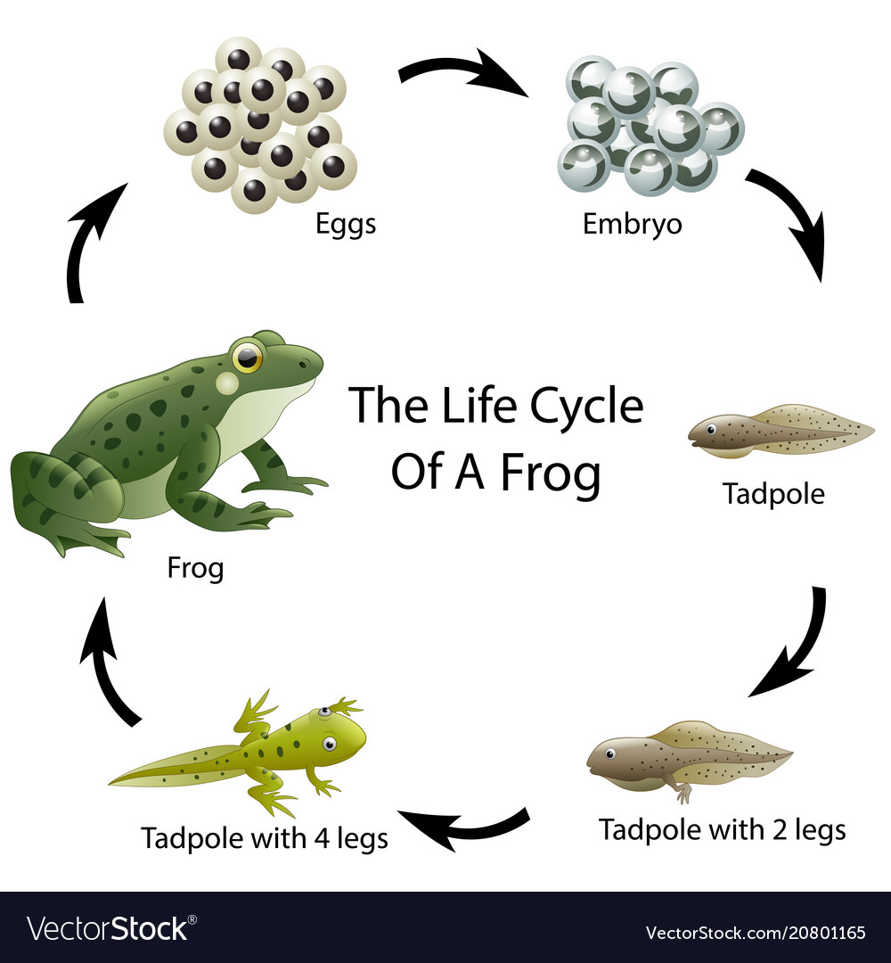
The new normal…
Observing over time
Experiments could be set up in a place that is visible to all members of the class so they can observe what is happening. Alternatively, individual children could describe what is happening to the rest of the class. Some examples:
Growing a seed in a glass jar
How does a nail in saltwater change over time?
Which brand of battery lasts the longest? Put different brands of batteries into torches. Switch them on and observe how long they last.

Slide 17
The new normal…
Pattern Seeking
Instead of the children carrying out experiments and collecting data the teacher could give them the data which they then interpret and look for patterns in. This could be real data or data that the teacher has created.
Problem Solving/Exploration
There are lots of easy to resource, simple science investigations that children can do individually. These activities use resources like an empty plastic bottle which once used can be recycled. Three great places to go for ideas:
Marvin and Milo, https://spark.iop.org/collections/marvin-and-milo#gref
The Royal Institution Experimental, https://www.rigb.org/families/experimental
PSTT, Science Fun at Home (also applicable to school), https://pstt.org.uk/resources/curriculum-materials/Science-Fun-at-Home

Slide 18
The new normal…
NCETM – Where’s the maths in that, https://www.ncetm.org.uk/resources/46490
RSC ideas webs, https://edu.rsc.org/resources/collections/science-ideas-webs

Slide 19
The new normal…
Some final thoughts…
Teacher homemade demo kits
Have physically distanced chat/send them an e-mail
Give them a pack
Start collecting resources
Boxes, empty bottles, empty margarine tubs

Slide 20
The new normal…
Feedback please!

