Slide 1
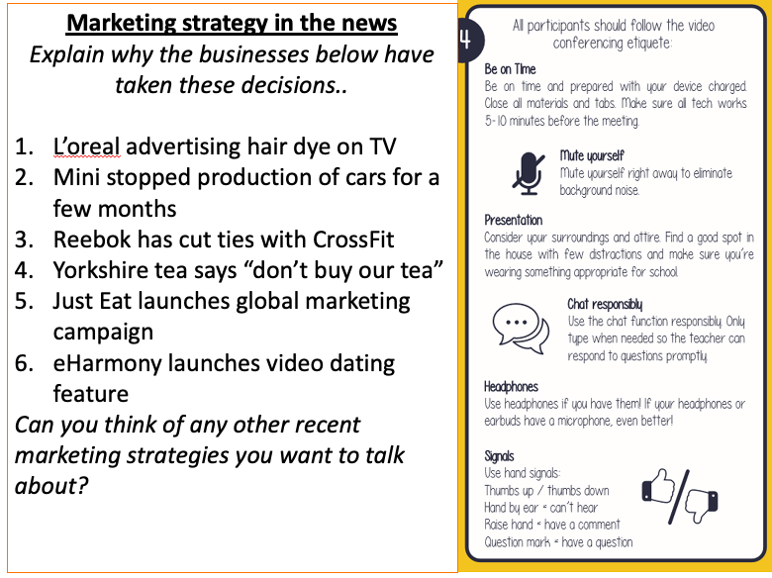
Live Meeting Starters - Business
Purposeful start to live meetings whilst waiting for students to join

