Slide 1
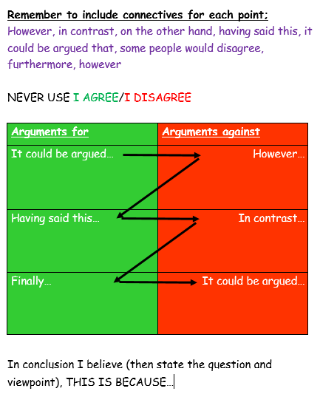
Task: In partners letter yourselves a & b. A’s you are agreeing with the statement, B’s you are disagreeing. You have 2 minutes to plan your responses to the below statement; The creation account should be read literally Now in partners using the speaking frame debate the question using your own points, OR disagreeing with your partners

