Slide 1
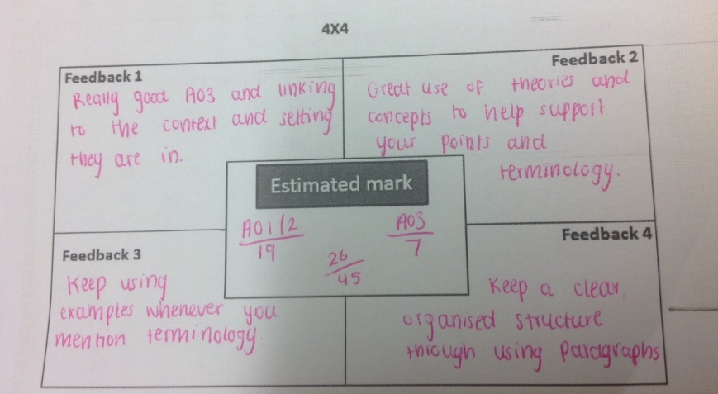
Critical buddy condenses teacher feedback into 4 main points for their partner’s essay – promotes understanding, explaining, summarising, sharing feedback

Slide 2
Buddy presenting 4x4 feedback to the writer promotes:
Discussion of teacher feedback
Comparison of their essay with others’
Clarity and motivation to ACT on feedback in their second draft

Slide 3
Showing progress over time and evaluates whether students have ACTed on feedback
Second essay – teacher marks where they have met or not met 4x4 feedback from first draft

Slide 4
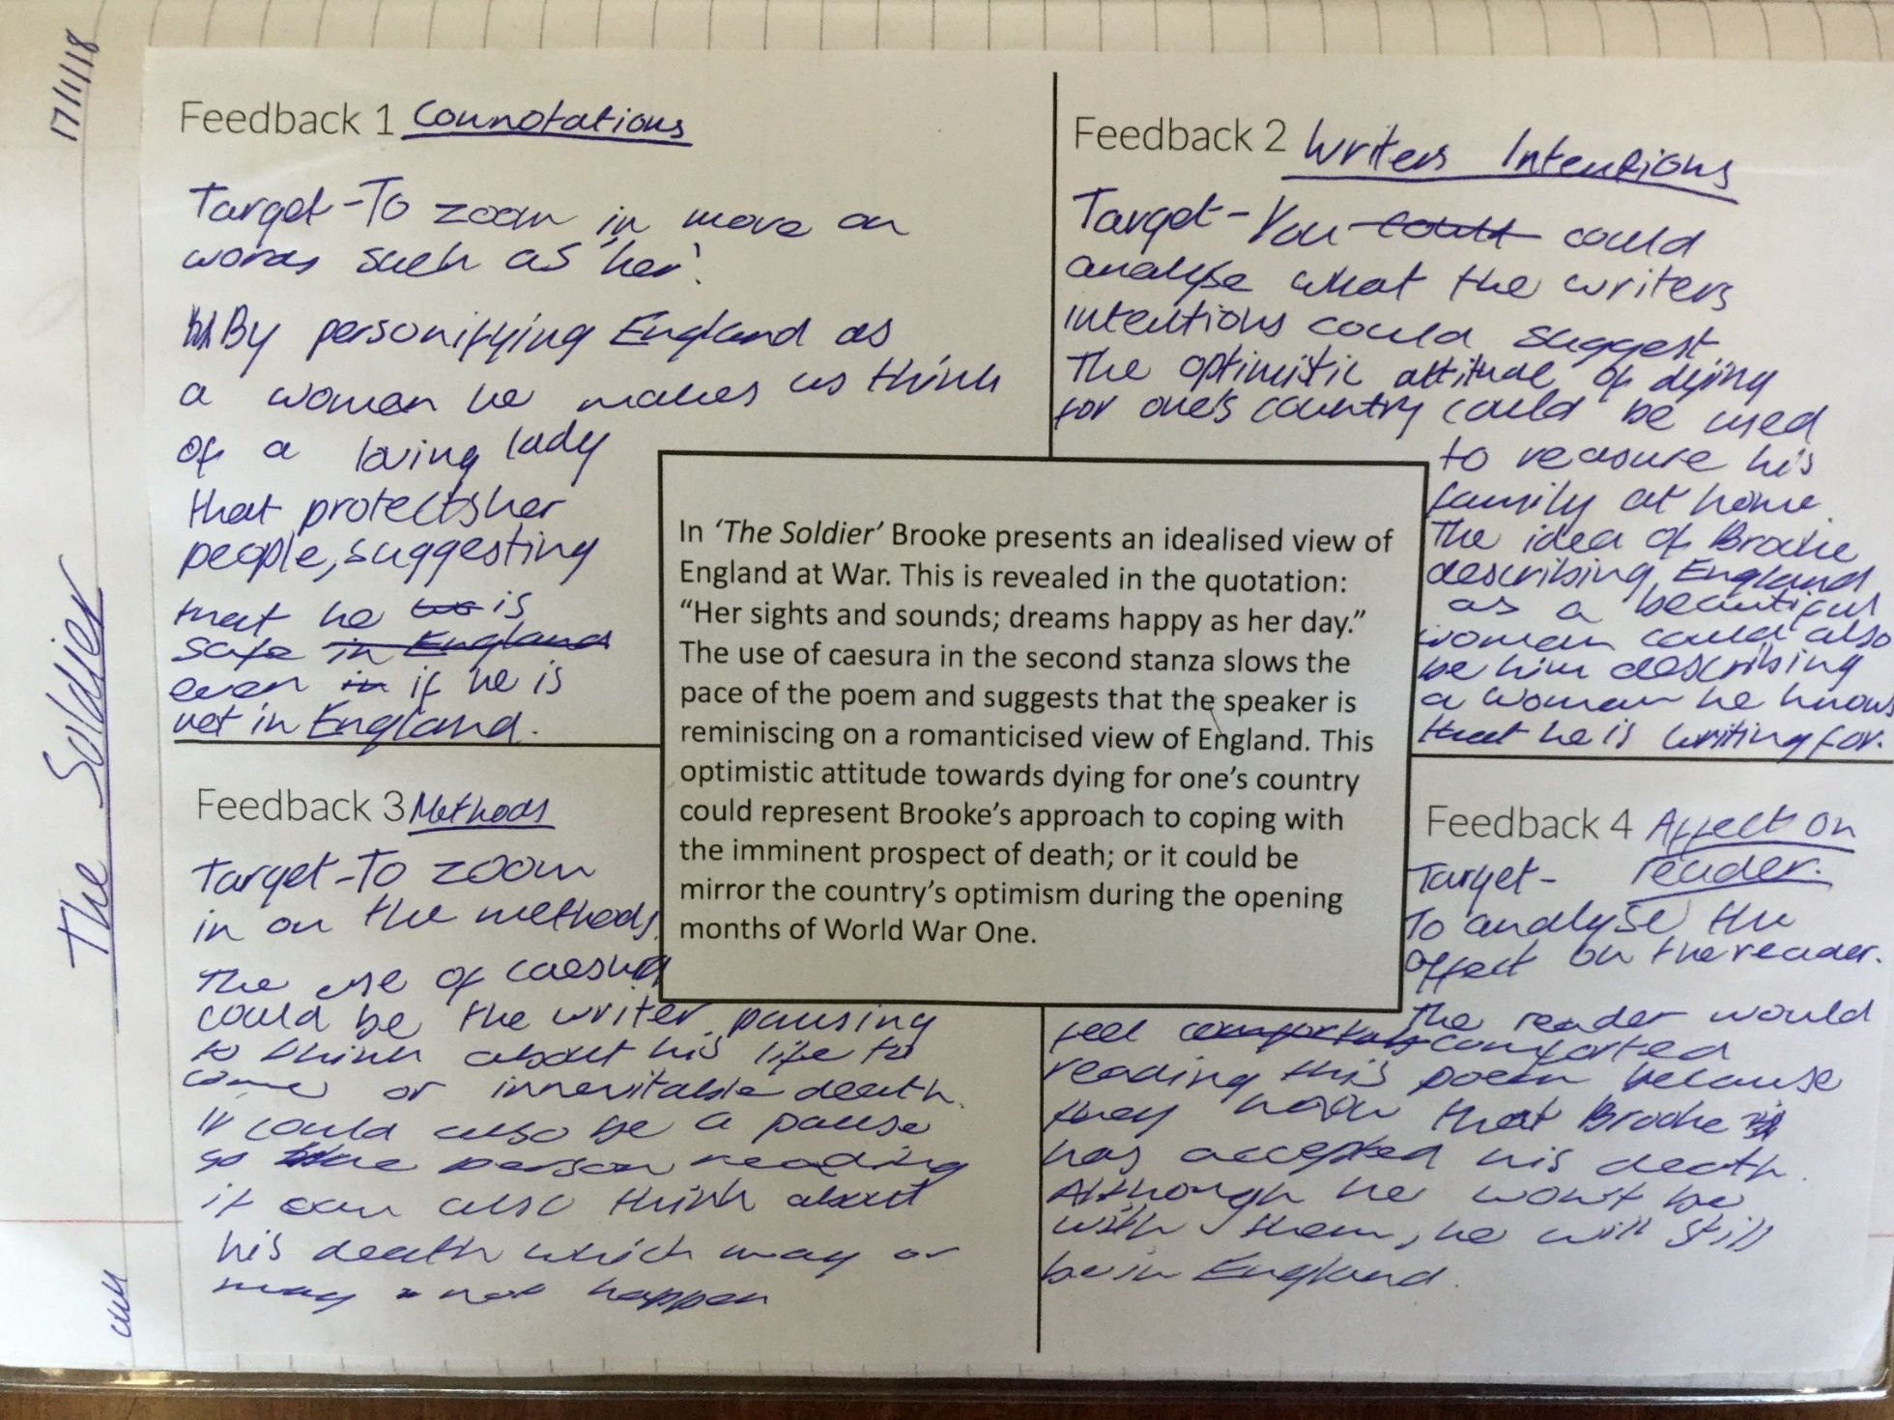
Students identify 4 x improvements for model answer – generating feedback promotes understanding of how to progress
Re-write (with specific focus):
Model answer

Slide 5
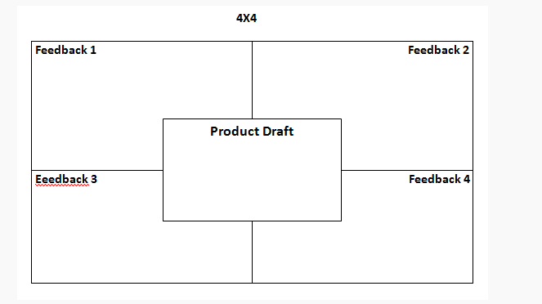
4 x 4 used for ABC feedback to improve
Agree with a point…..
Build on a point…
Feedback 3
The ABC I need to work on is:
I know my work has improved because:
Challenge the view that…

