Slide 1
Year 6 SPAG Expanded noun phrases
NCLO: Using expanded noun phrases to convey complicated information concisely.

Slide 2
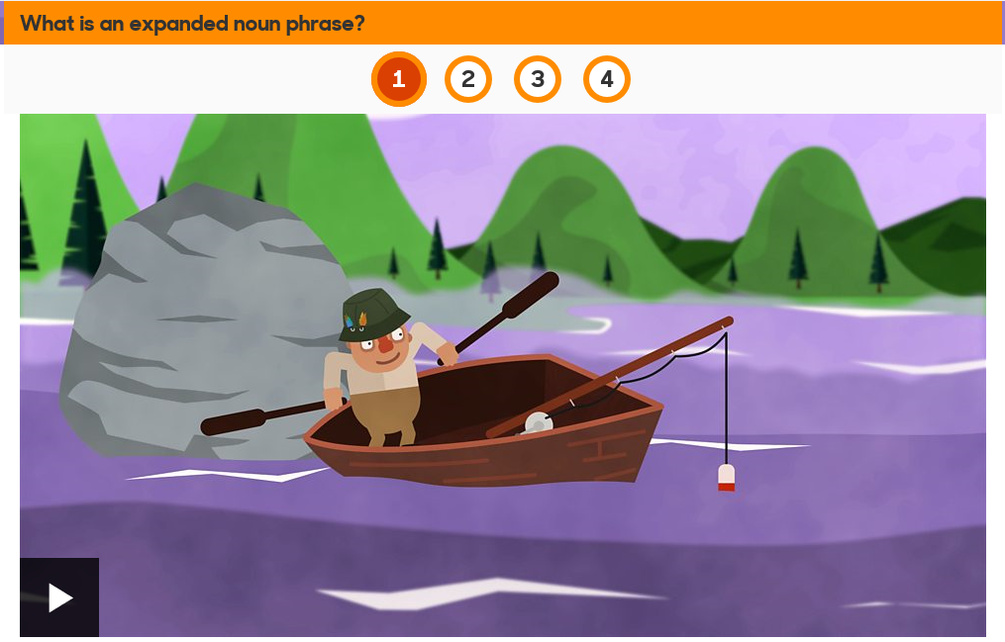
Recap on expanded noun phrases
http://www.bbc.co.uk/guides/z3nfw6f#z8xt2nb

Slide 3
Noun phrases can begin with:
Definite article: the cat
Indefinite article: a cat
Demonstrative adjectives: that cat / this cat / those cats / these cats
Possessive adjectives: her cat / their cat

Slide 4
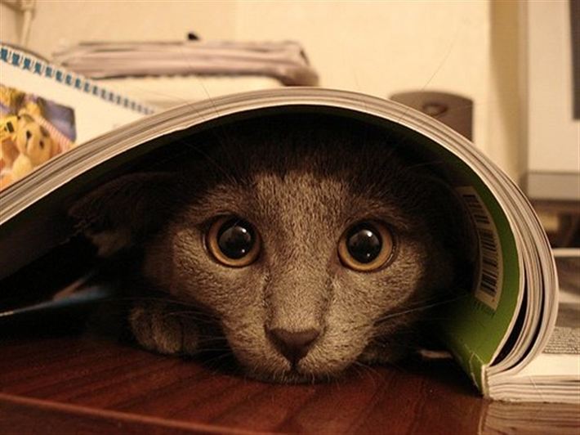
A noun phrase can be expanded with:
Adjectives
A timid cat
Possessive nouns
The neighbour’s cat

Slide 5
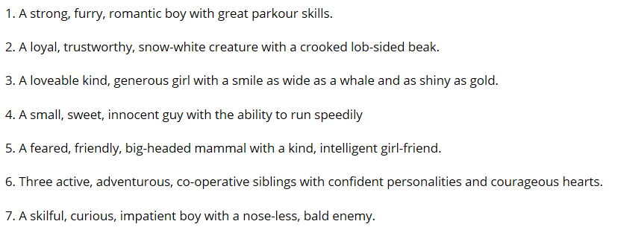
Here are some expanded noun phrases – can you guess who they describe?

Slide 6
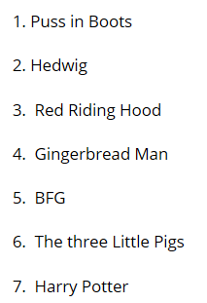
Answers

Slide 7
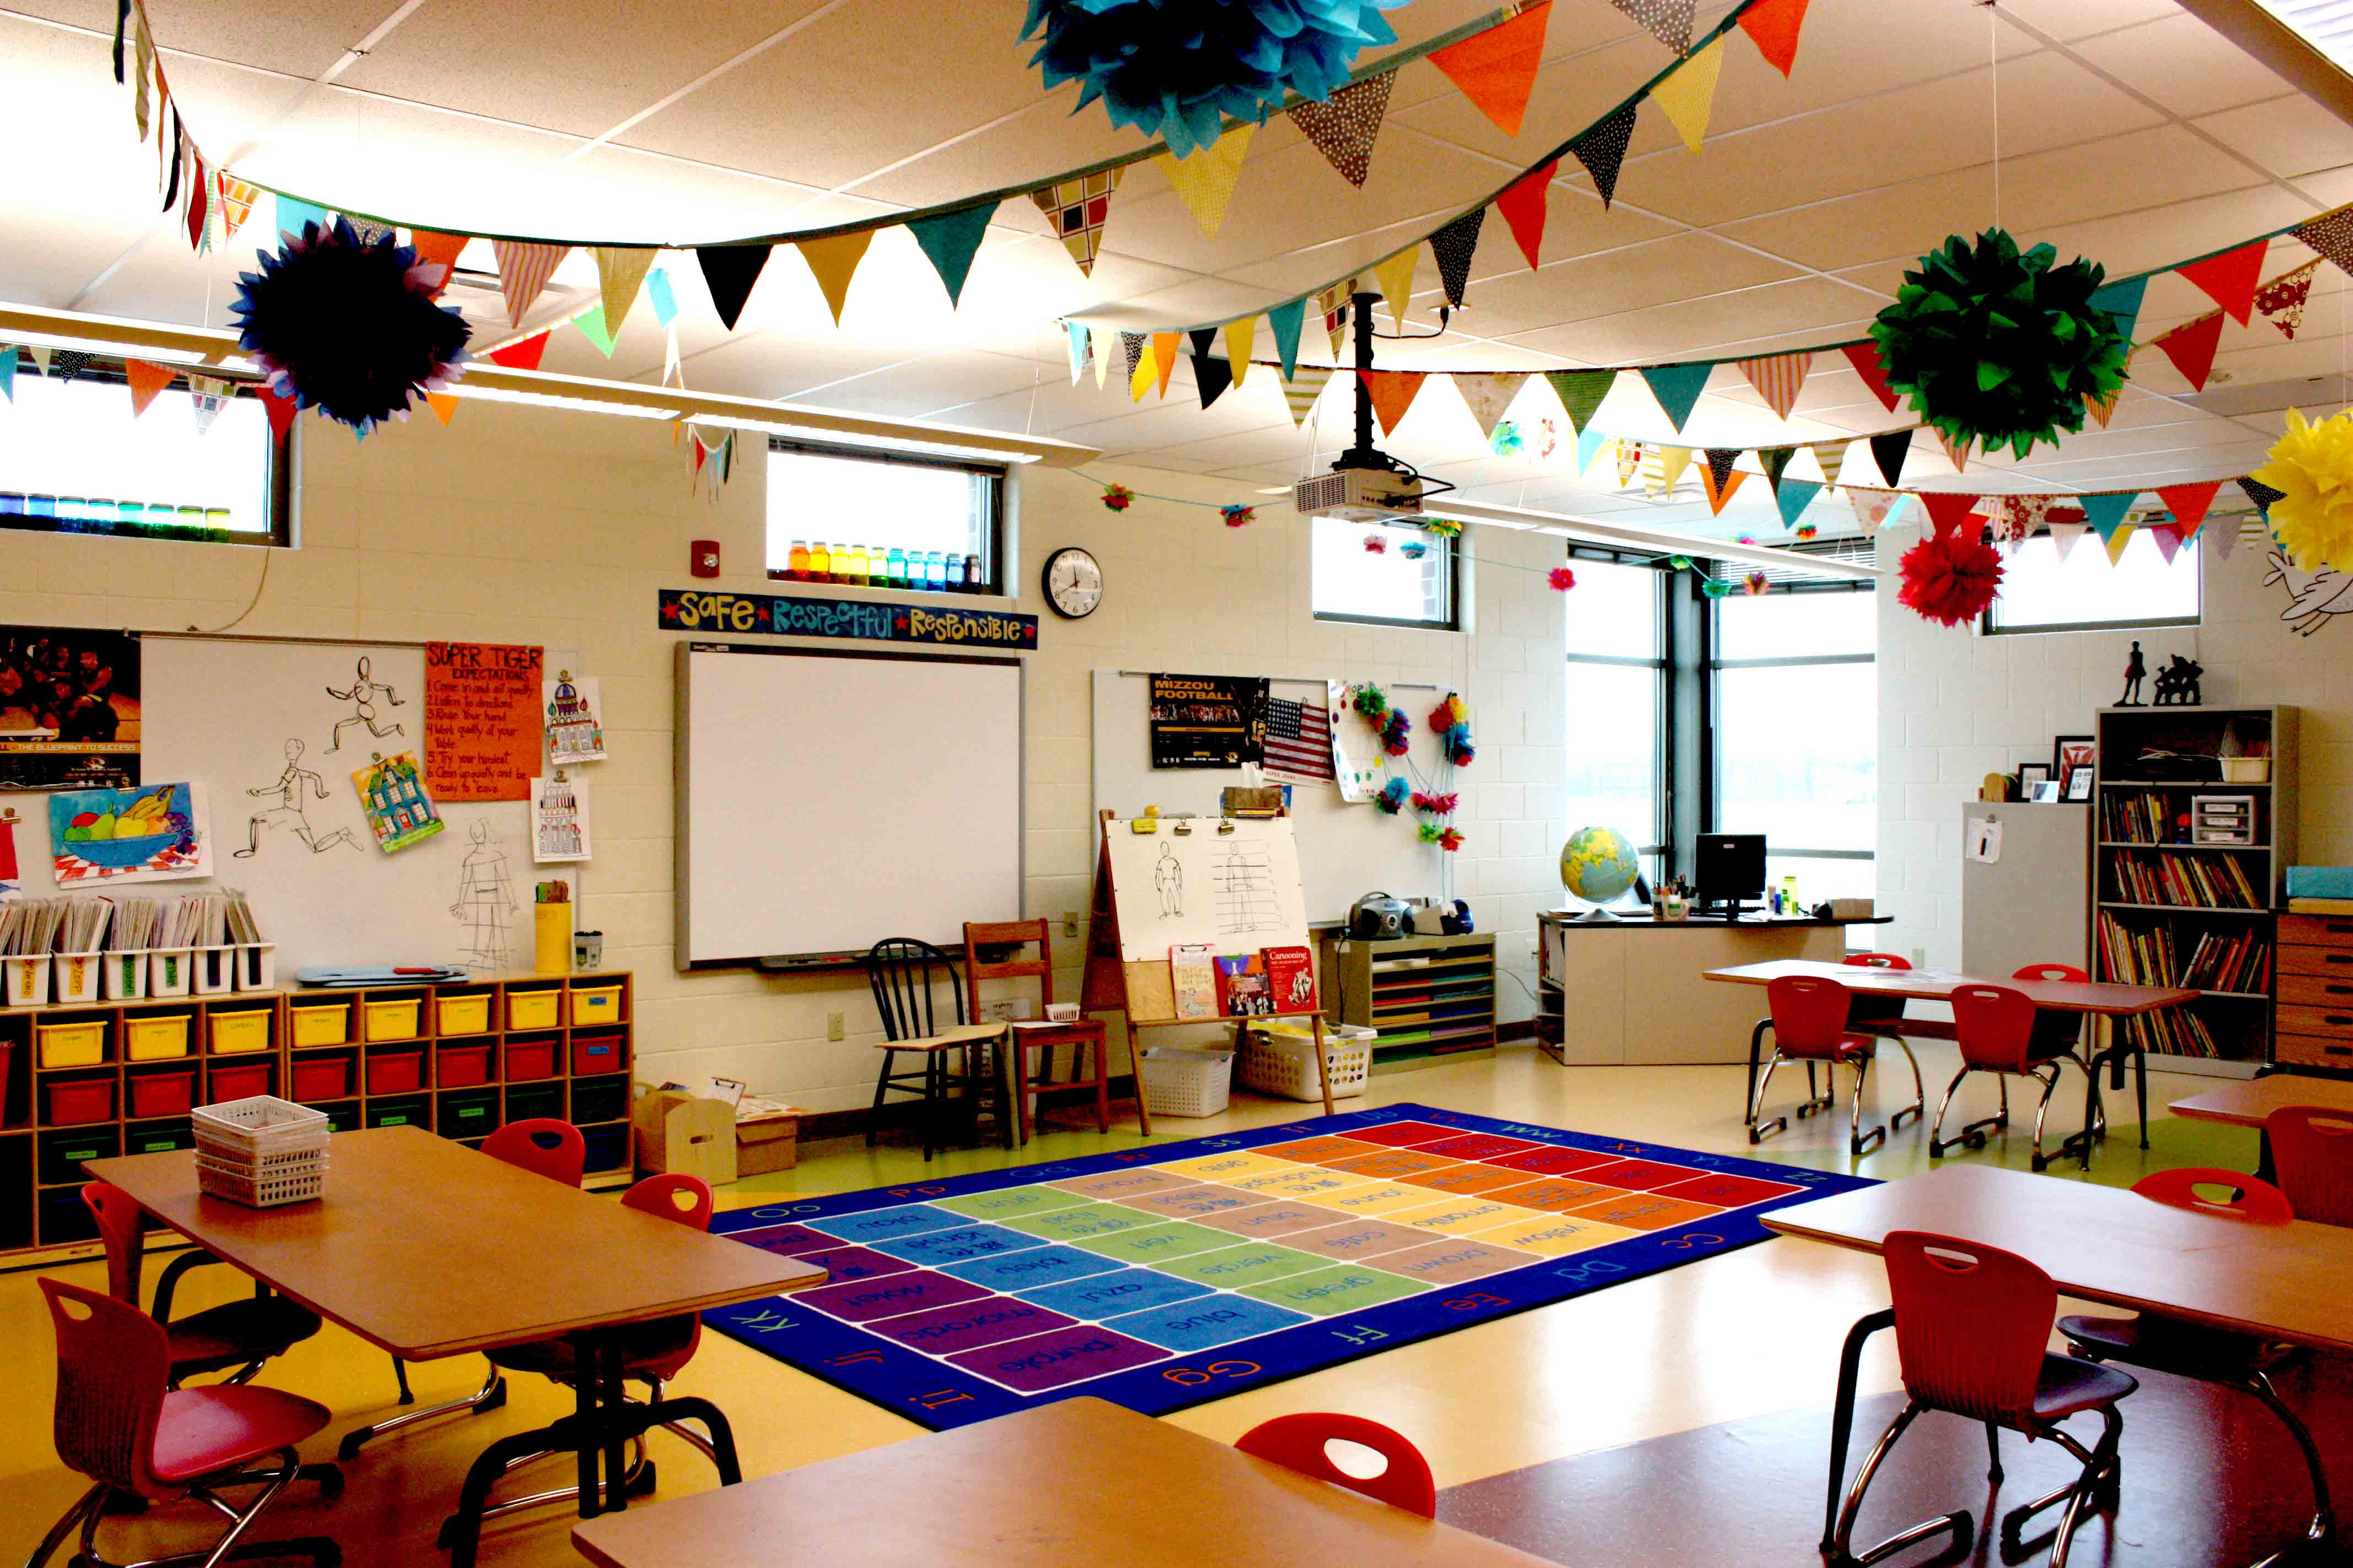
Can you create your own noun phrase quiz based on things or people in your classroom?

