Slide 1
Year 4 SPAG
NCLO:
To use paragraphs to organise ideas around a theme.

Slide 2
Why do we use paragraphs?
We use paragraphs to help us organise our writing.
Writing makes much more sense if it’s split up into ‘chunks’ (paragraphs)….why?
If we just use one long paragraph in our writing,
it’s much harder to read and understand.

Slide 3
How to write a good paragraph?
1) Write a topic sentence that sets the scene and tells the reader what the paragraph is going to be about.
2) Next add at least 3 development sentences, they could tell the reader some of the following things:
add facts
add details
tell the reader about something that happens
give reasons for what happens
3) Finish your paragraph with a concluding sentence.

Slide 4
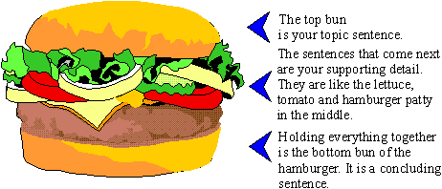
The paragraph cheeseburger

Slide 5
Topic sentence:
It was the most beautiful autumn morning that Molly thought she had ever seen.
Development sentences :
The sky was bright blue without a single cloud to clutter it up. There was a slight chill to the air which made Molly decide to wear a warm jacket. However the best thing of all (at least as far as Molly was concerned) was that the leaves on the trees had started to change colour. It wouldn’t be long now before they started to drop silently to the waiting ground below.
Concluding sentence :
Autumn was Molly’s favourite season of the year, she loved it!

Slide 6
When to start a new paragraph
There are 4 things that could change:
1. When something new happens- Whenever you talk about something new happening, you have to use a new paragraph.
2. When you talk about a new person- Whenever a new person appears in your writing, you should start a new paragraph. It shows the reader that something has changed.
3. When you write about a different place- Every time the story moves to another place, you need to start a new paragraph.
4. When the story or letter moves to a different time- Sometimes a story or a letter moves in time. It can go backwards or forwards to talk about something that happened at a different time.

Slide 7
TIPTOP
Remember the tiptop rule when you need to use a new paragraph…..
Person
Time
Place
Topic

