Slide 1
Year 3 SPAG
NCLO: Using conjunctions, adverbs and prepositions to express time and cause
Lesson 1: Adverbs

Slide 2
Verbs and Adverbs
Play the Verbs and Adverbs Game again, but this time turn around and perform an action/mime every time you hear an ADVERB.
The first person on each table to turn around at the adverb wins 1 point.

Slide 3
Improving Sentences
Adverbs are great!
They can help us make our sentences much more interesting.
Look at the photograph on the next page. Using the Adverb Bank there, create your own sentences on whiteboards with a partner.

Slide 4
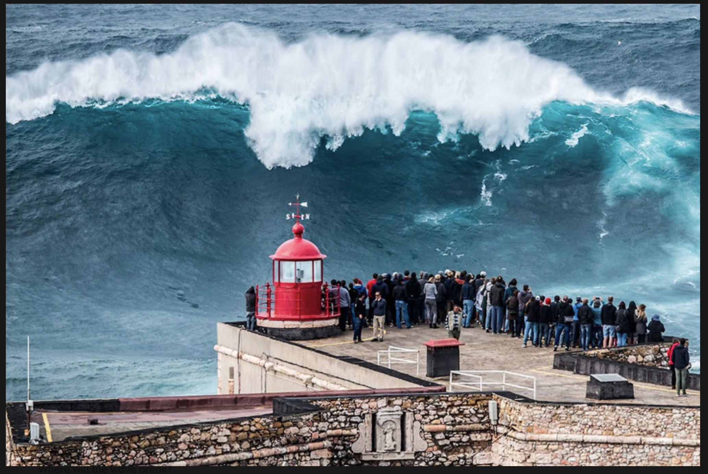
Improving Sentences
Adverb Bank
interestingly
surprisingly
next
before
unusually
weirdly
On whiteboards, create your own adverb sentences with a partner.
e.g. Interestingly, a huge wave rose out of the sea.

Slide 5
Improving Sentences
What sentences did you write?
Where did you use your adverbs?
Did anybody use adverbs in the middle of their sentences?
Can anybody re-order their own sentence using the same words, but in a different order?
e.g.
Interestingly, a huge wave rose out of the sea.
A huge wave interestingly rose out of the sea.

