Slide 1
Year 1 SPAG
Adding un to change verbs and adjectives.
NCLO: adding un to change the meaning of verbs and adjectives.

Slide 2
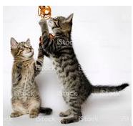
Adding un
We can add un to the beginning of words to make them the opposite meaning.

Slide 3
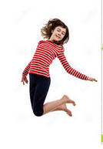
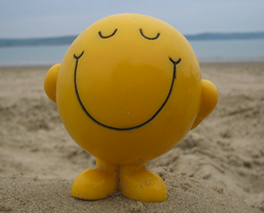
Adding un
We can add un to adjectives to make the opposite word.
happy
unhappy

Slide 4
Adding un
Act these opposite words out with your friend
We can add un to adjectives to make the opposite
tidy __tidy
friendly __friendly
fair __fair
fit __fit
lucky __lucky

Slide 5
Adding un
Act these opposite words out with your friend
We can add un to words to give the opposite meaning.
Fold --fold
seen __seen
true __true
able __able
tie __tie
Kind __kind

