Slide 1
Year 6 Spring Block 2
Percentages
NCLO: To convert fractions to percentages

Slide 2
Key vocabulary and questions
What does the word ‘percent’ mean? How can you represent this?
Which denominator is the easiest to convert into a percentage? Why is this easiest? Which other denominators are easier to convert into percentages?
If the denominator is 50, 25, 20 or 10 how would you convert it in to 100? What would you need to do to the numerator?

Slide 3
Fluency

Slide 4
Fluency

Slide 5
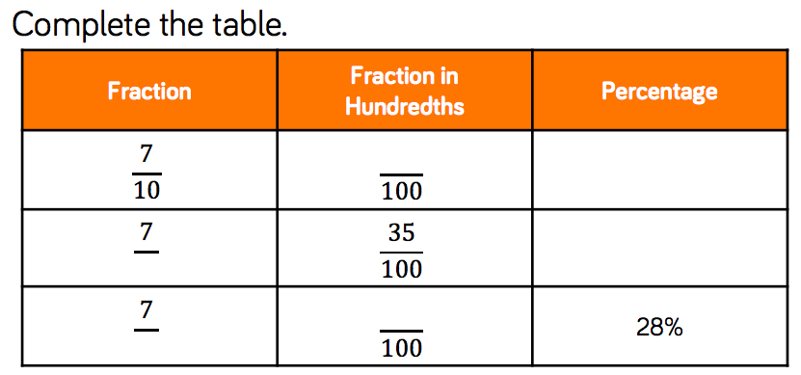
Fluency

Slide 6
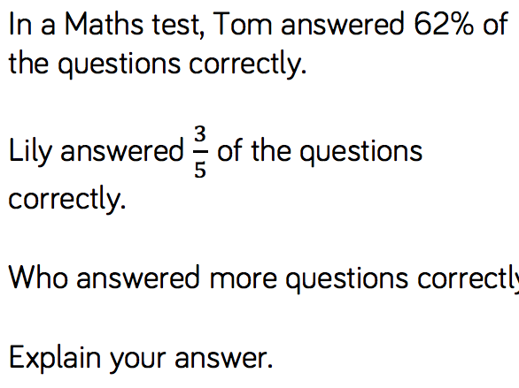
Reasoning and problem solving

Slide 7
Reasoning and problem solving

Slide 8
Year 6 Spring Block 2
Percentages
NCLO: To find equivalent fractions, decimals and percentages

Slide 9
Key vocabulary and questions
How does converting a decimal to a fraction help us to convert it to a percentage?
When I convert a decimal to a percentage, what do I need to multiply by? Can I use a place value grid to help me convert the decimal to a percentage?

Slide 10
Fluency

Slide 11
Fluency

Slide 12
Fluency

Slide 13
Reasoning and problem solving

Slide 14
Reasoning and problem solving

Slide 15
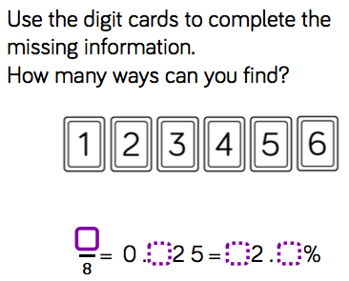
Reasoning and problem solving

Slide 16
Year 6 Spring Block 2
Percentages
NCLO: To find a percentage of an amount

Slide 17
Key vocabulary and questions
How many other ways could you find 25%? Which is the most effective?
If you know how to calculate 10%, how can you use this to calculate 1%?
What’s the same and what’s different about 10% of 300, 30 and 3? What do you notice?

Slide 18
Fluency

Slide 19
Fluency

Slide 20
Fluency

Slide 21
Reasoning and problem solving

Slide 22
Reasoning and problem solving

Slide 23
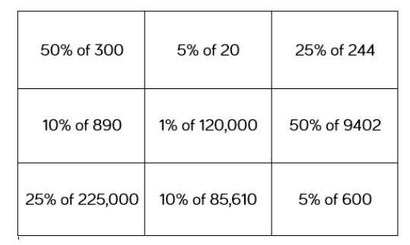
Reasoning and problem solving

Slide 24
Year 6 Spring Block 2
Percentages
NCLO: To find a percentage of an amount

Slide 25
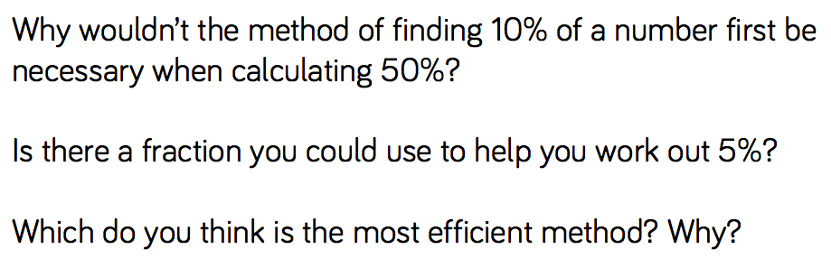
Key vocabulary and questions

Slide 26
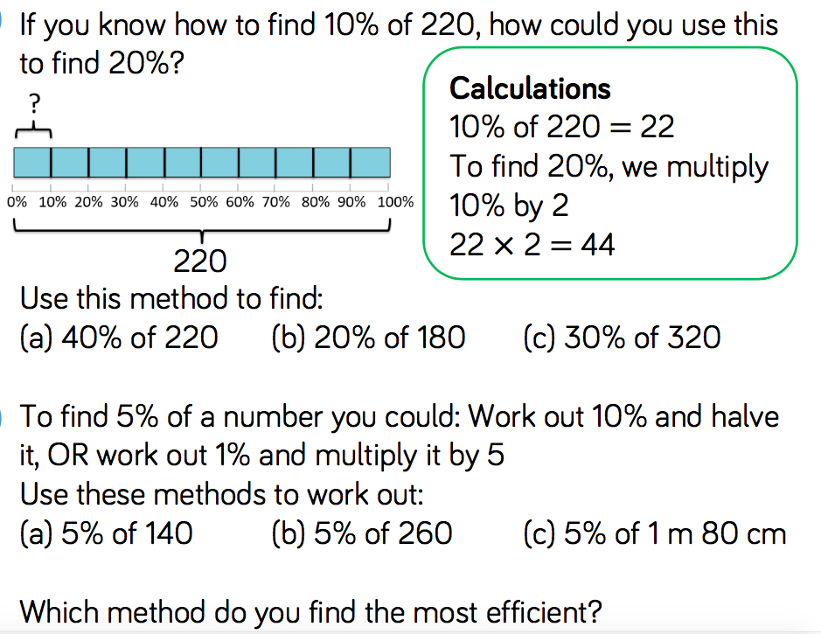
Fluency

Slide 27
Fluency

Slide 28
Fluency

Slide 29
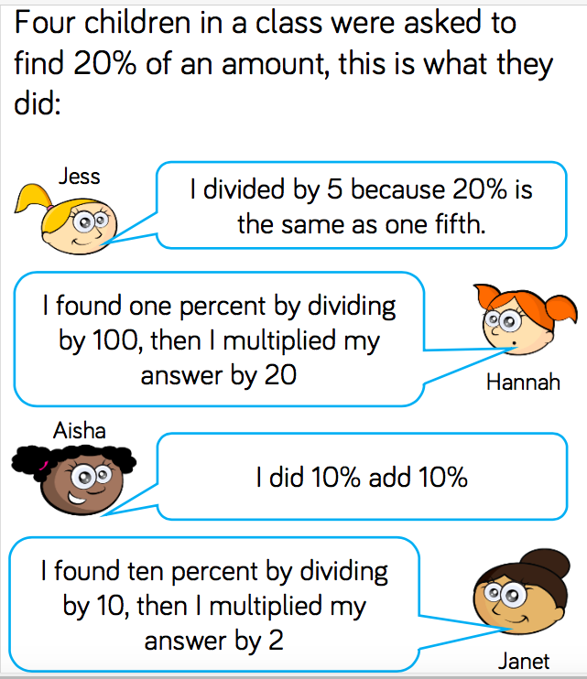
Reasoning and problem solving

Slide 30
Reasoning and problem solving

Slide 31
Year 6 Spring Block 2
Percentages
NCLO: To use understanding of finding percentages of amounts to find missing values

Slide 32
Key vocabulary and questions
Is there more than one way to solve the problem?
What is the most efficient way to find ___%?
What diagrams could help you visualise this problem?

Slide 33
Fluency

Slide 34
Fluency

Slide 35
Fluency

Slide 36
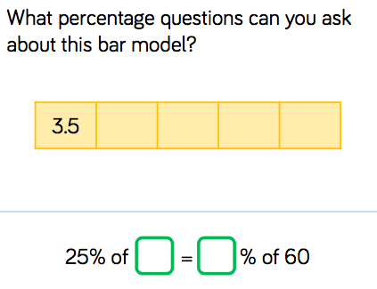
Reasoning and problem solving

Slide 37
Reasoning and problem solving

Slide 38
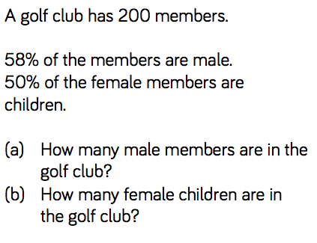
Reasoning and problem solving

Slide 39
Year 6 Spring Block 2
Percentages
NCLO: To calculate percentage increase and decrease

Slide 40
Key vocabulary and questions
What does increase/decrease mean? How does the bar model show the percentage increase/decrease?
If prices increase by 20%, what percentage will represent the new price?
If the percentage decrease is ___, how can we work out the original price? What will the new price be?

Slide 41
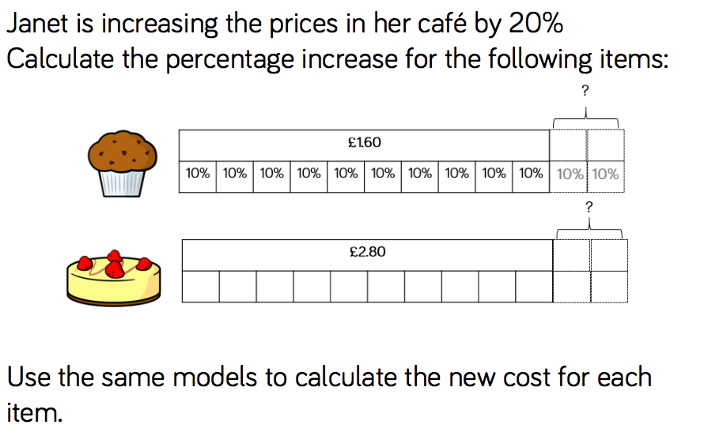
Fluency

Slide 42
Fluency

Slide 43
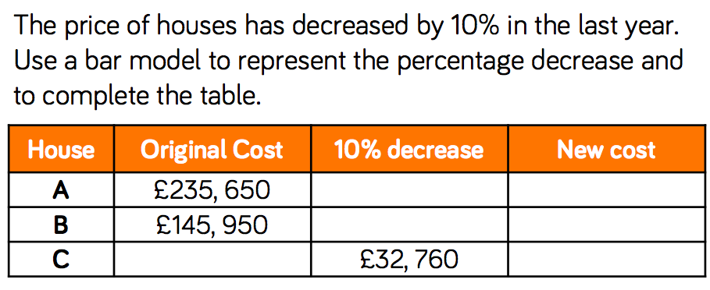
Fluency

Slide 44
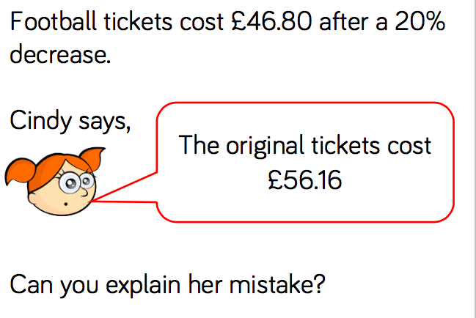
Reasoning and problem solving

Slide 45
Reasoning and problem solving

Slide 46
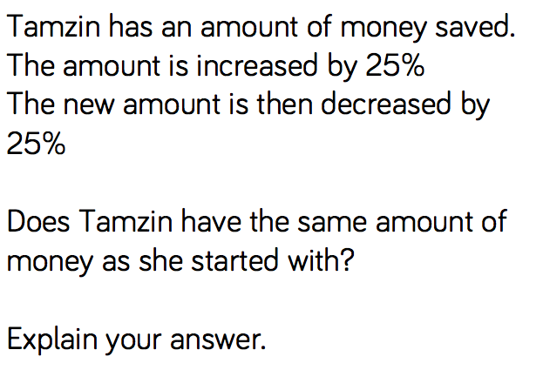
Reasoning and problem solving

Slide 47
Year 6 Spring Block 2
Percentages
NCLO: To order fractions, decimals and percentages

Slide 48
Key vocabulary and questions

Slide 49
Fluency

Slide 50
Fluency

Slide 51
Fluency

Slide 52
Fluency

Slide 53
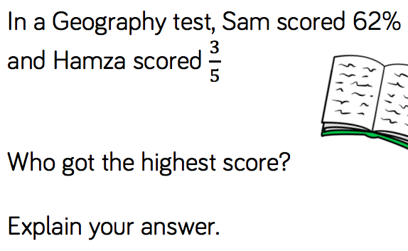
Reasoning and problem solving

Slide 54
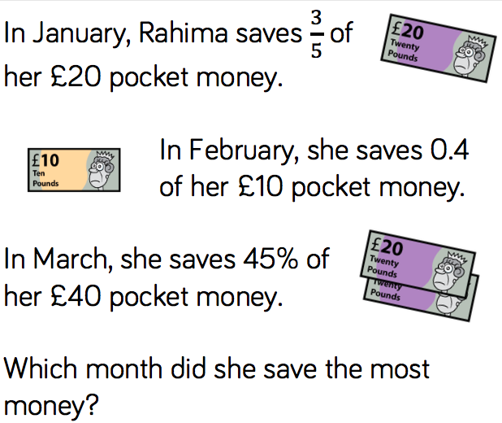
Reasoning and problem solving

Slide 55
Reasoning and problem solving

