Slide 1
Year 1 Block 1 Number: Place Value
Sort objects
NCLO: Identify and represent numbers using objects and pictorial representations including the number line, and use the language of: equal to, more than, less than (fewer), most, least.

Slide 2
Key vocabulary and questions
Sort, Group

Slide 3
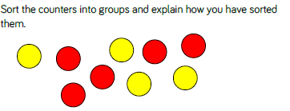
Fluency

Slide 4
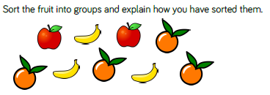
Fluency

Slide 5
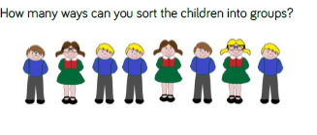
Fluency

Slide 6
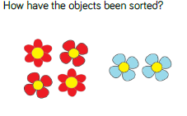
Reasoning and problem solving

Slide 7
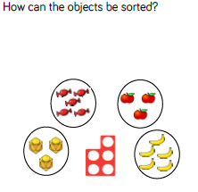
Reasoning and problem solving

Slide 8
Year 1 Block 1 Number: Place Value
Count objects
NCLO: Count to ten forwards and backwards, beginning with 0 or 1, or from any given number.

Slide 9
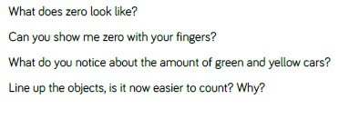
Key vocabulary and questions
Count, Zero, Amount

Slide 10
Fluency

Slide 11
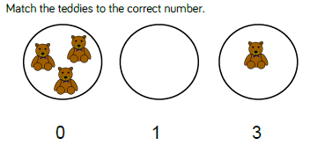
Fluency

Slide 12
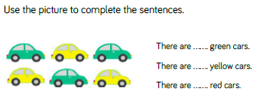
Fluency

Slide 13
Year 1 Block 1 Number: Place Value
Represent objects
NCLO: Count to ten forwards and backwards, beginning with 0 or 1, or from any given number.

Slide 14
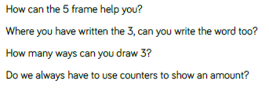
Key vocabulary and questions
Zero, model, write, represent

Slide 15
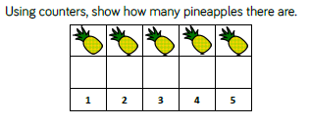
Fluency

Slide 16
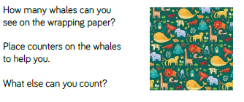
Fluency

Slide 17
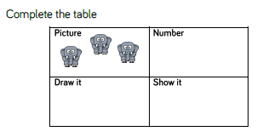
Fluency

Slide 18
Reasoning and problem solving

Slide 19
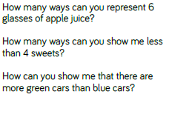
Reasoning and problem solving

Slide 20
Year 1 Block 1 Number: Place Value
Count, read and write backwards from any number 0 to 10.
NCLO: Count, read and write numbers to 10 in numerals and words.

Slide 21
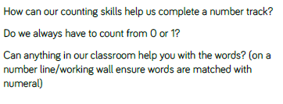
Key vocabulary and questions
count, number sequence, numerals, words, images

Slide 22
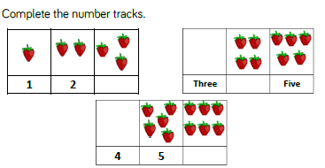
Fluency

Slide 23
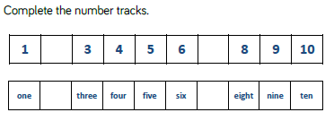
Fluency

Slide 24
Fluency

Slide 25
Year 1 Block 1 Number: Place Value
Count one more
NCLO: Given a number, identify one more or one less.

Slide 26
Key vocabulary and questions
count, number sequence, numerals, words, images

Slide 27
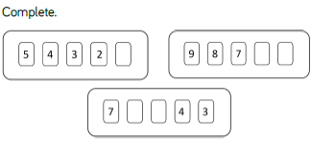
Fluency

Slide 28
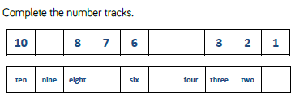
Fluency

Slide 29
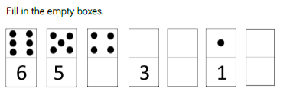
Fluency

Slide 30
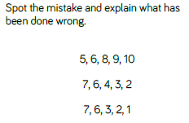
Reasoning and problem solving

Slide 31
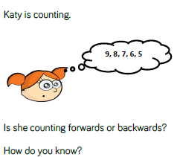
Reasoning and problem solving

Slide 32
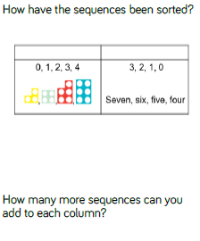
Reasoning and problem solving

Slide 33
Year 1 Block 1 Number: Place Value
Count one less
NCLO: Given a number, identify one more or one less.

Slide 34
Key vocabulary and questions
one less

Slide 35
Fluency

Slide 36
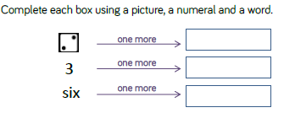
Fluency

Slide 37
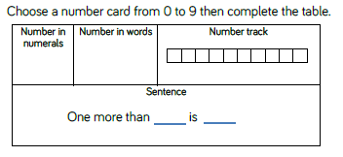
Fluency

Slide 38
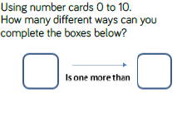
Reasoning and problem solving

Slide 39
Reasoning and problem solving

Slide 40
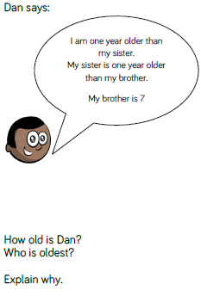
Reasoning and problem solving

Slide 41
Year 1 Block 1 Number: Place Value
One to one correspondence to start to compare groups
NCLO: Identify and represent numbers using objects and pictorial representations including the number line, and use the language of: equal to, more than, less than (fewer), most, least.

Slide 42
Key vocabulary and questions
one less, counting

Slide 43
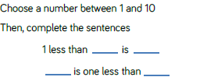
Fluency

Slide 44
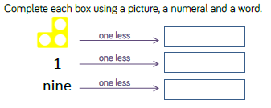
Fluency

Slide 45
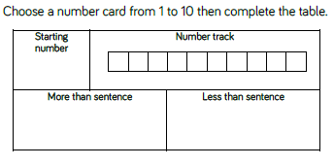
Fluency

Slide 46
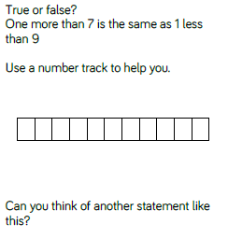
Reasoning and problem solving

Slide 47
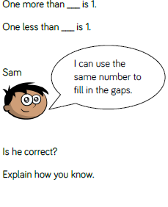
Reasoning and problem solving

Slide 48
Year 1 Block 1 Number: Place Value
Compare groups using language such as equal, more/greater, less/fewer
NCLO: Identify and represent numbers using objects and pictorial representations including the number line, and use the language of: equal to, more than, less than (fewer), most, least.

Slide 49
Key vocabulary and questions
many, enough, difference, amount

Slide 50
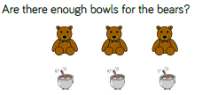
Fluency

Slide 51
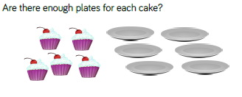
Fluency

Slide 52
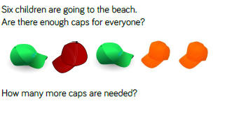
Fluency

Slide 53
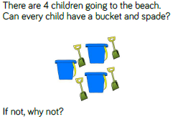
Reasoning and problem solving

Slide 54
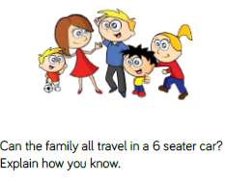
Reasoning and problem solving

Slide 55
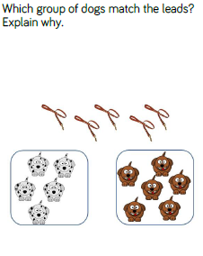
Reasoning and problem solving

Slide 56
Year 1 Block 1 Number: Place Value
Introduce =, > and < symbols
NCLO: Identify and represent numbers using objects and pictorial representations including the number line, and use the language of: equal to, more than, less than (fewer), most, least.

Slide 57
Key vocabulary and questions
equal to, more than, less than, greater than, fewer, more, compare

Slide 58
Fluency

Slide 59
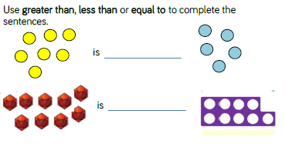
Fluency

Slide 60
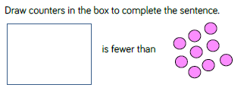
Fluency

Slide 61
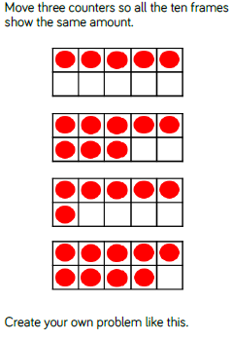
Reasoning and problem solving

Slide 62
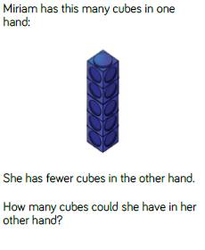
Reasoning and problem solving

Slide 63
Year 1 Block 1 Number: Place Value
Compare numbers
NCLO: Identify and represent numbers using objects and pictorial representations including the number line, and use the language of: equal to, more than, less than (fewer), most, least.

Slide 64
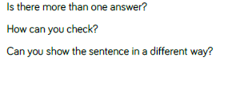
Key vocabulary and questions
equal to, more than, less than, greater than, fewer, more, compare

Slide 65
Fluency

Slide 66
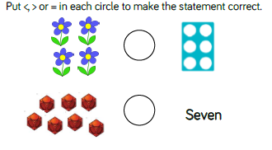
Fluency

Slide 67
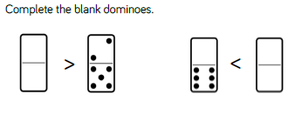
Fluency

Slide 68
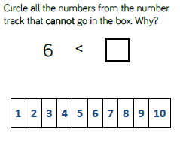
Reasoning and problem solving

Slide 69
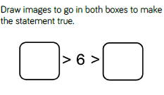
Reasoning and problem solving

Slide 70
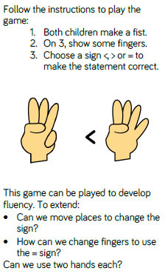
Reasoning and problem solving

Slide 71
Year 1 Block 1 Number: Place Value
Order groups of objects
NCLO: Identify and represent numbers using objects and pictorial representations including the number line, and use the language of: equal to, more than, less than (fewer), most, least.

Slide 72
Key vocabulary and questions
equal to, more than, less than, greater than, fewer, more, compare

Slide 73
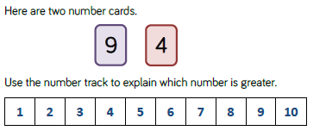
Fluency

Slide 74
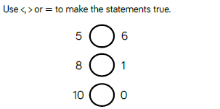
Fluency

Slide 75
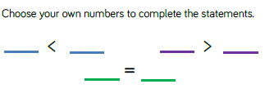
Fluency

Slide 76
Reasoning and problem solving

Slide 77
Reasoning and problem solving

Slide 78
Reasoning and problem solving

Slide 79
Year 1 Block 1 Number: Place Value
Order numbers
NCLO: Identify and represent numbers using objects and pictorial representations including the number line, and use the language of: equal to, more than, less than (fewer), most, least.

Slide 80
Key vocabulary and questions
equal to, more than, less than, greater than, fewer, more, compare

Slide 81
Fluency

Slide 82
Fluency

Slide 83
Fluency

Slide 84
Reasoning and problem solving

Slide 85
Reasoning and problem solving

Slide 86
Year 1 Block 1 Number: Place Value
Ordinal numbers (1st, 2nd, 3rd…)
NCLO: Identify and represent numbers using objects and pictorial representations including the number line, and use the language of: equal to, more than, less than (fewer), most, least.

Slide 87
Key vocabulary and questions
equal to, more than, less than, greater than, fewer, more, compare, prove it

Slide 88
Fluency

Slide 89
Fluency

Slide 90
Fluency

Slide 91
Reasoning and problem solving

Slide 92
Reasoning and problem solving

Slide 93
Year 1 Block 1 Number: Place Value
The number line
NCLO: Identify and represent numbers using objects and pictorial representations including the number line, and use the language of: equal to, more than, less than (fewer), most, least.

Slide 94
Key vocabulary and questions
equal to, more than, less than, greater than, fewer, more, compare, prove it

Slide 95
Fluency

Slide 96
Fluency

Slide 97
Fluency

Slide 98
Reasoning and problem solving

Slide 99
Reasoning and problem solving

Slide 100
Reasoning and problem solving

Slide 101
Reasoning and problem solving

